Slide 1
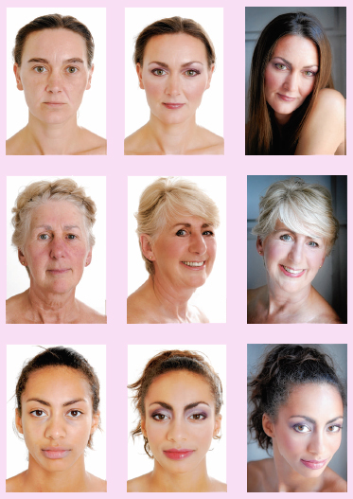
Makeovers

Slide 2
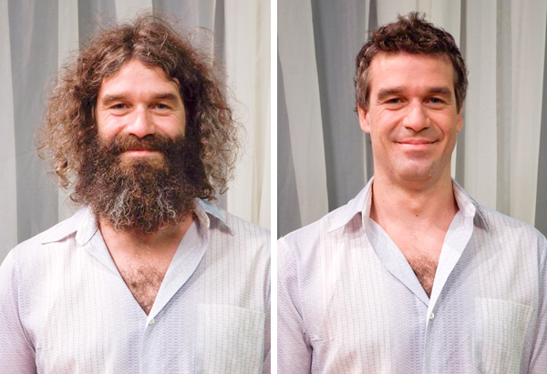
Ask and answer in pairs:
What differences do you find in this makeover?
Would you like to have a makeover?

Slide 3
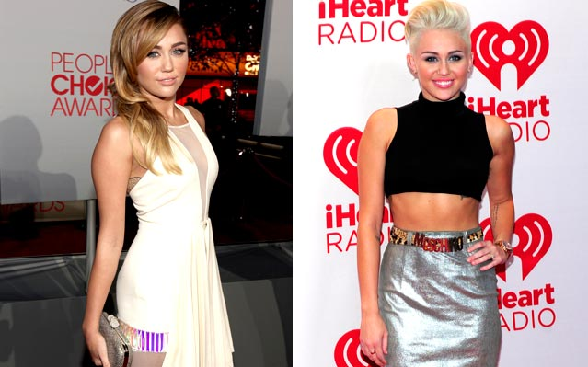
Grammar: Compare using as…as
(not)as (adjective) as
Before
After
Her hair isn’t as long as before.
Her hair color isn’t as dark as before.
She looks as pretty as before.

Slide 4
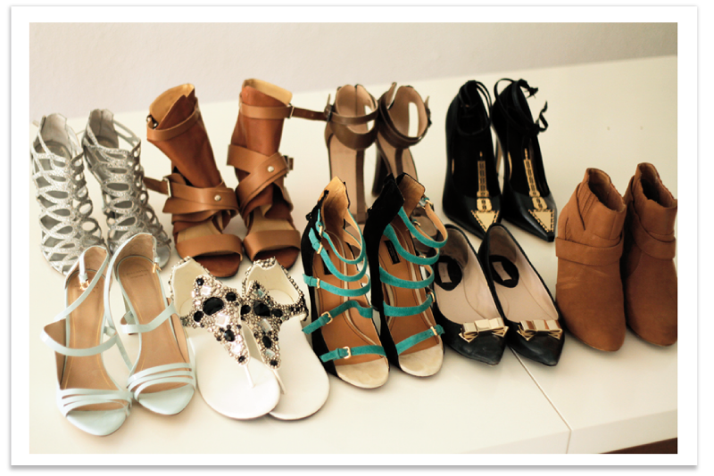
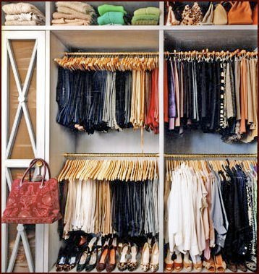
(not)as (noun) as
Countable nouns
as few ……….. as
as many ………..as
I have as few shoes as you do.
I have as many clothes as you do.

Slide 5
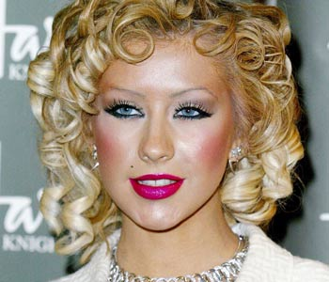
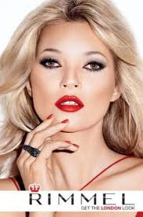
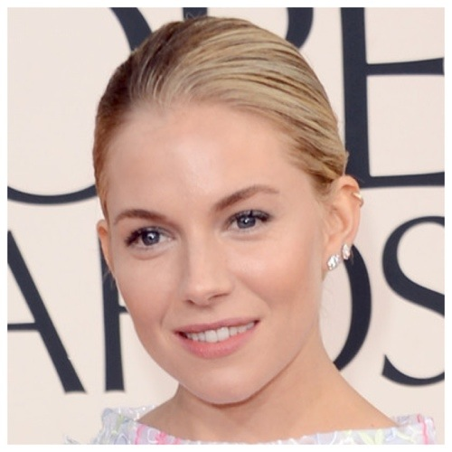
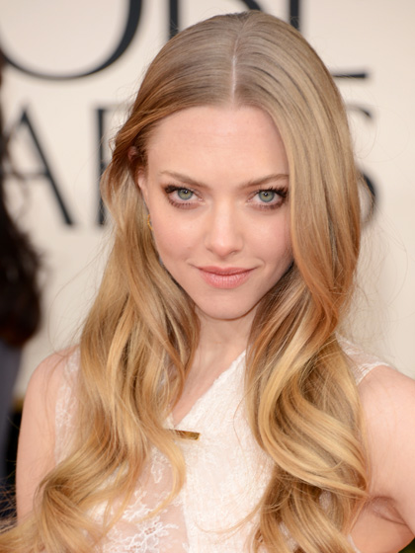
Uncountable nouns
as little ……….. as
as much ………..as
Christina wears as much make-up as Kate.
Sienna wears as little make-up as Amanda.

Slide 6
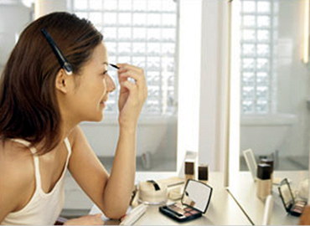
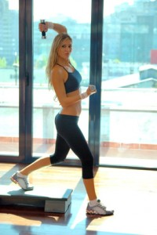
(not)as (adverb) as
I make up as quick as possible.
I work out as often as possible.

Slide 7
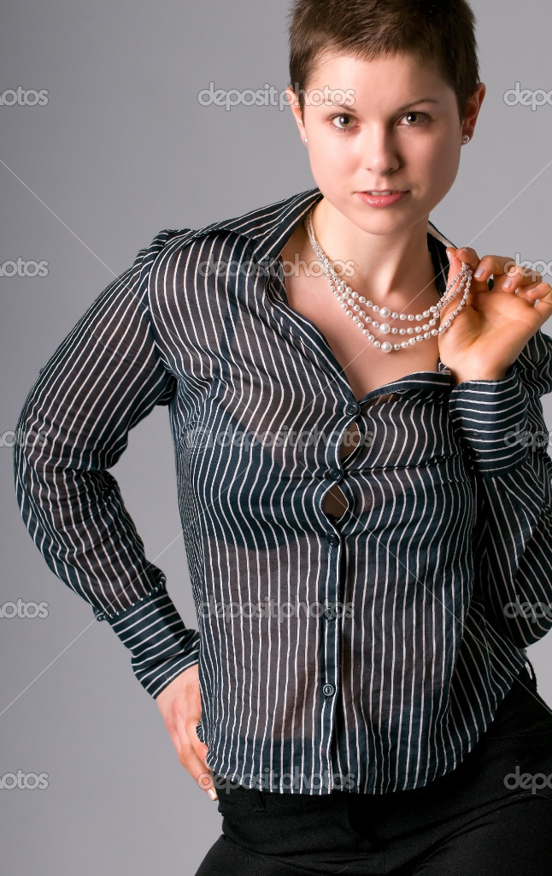
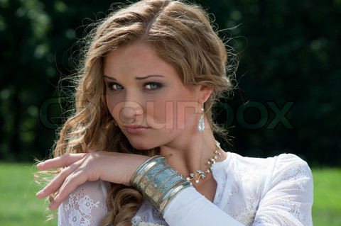
Exercises:
Sachi
Nell

Slide 8
Pretty- Sachi is as pretty as Nell.
( hair / short )
(much jewelry )
(earrings / big)
(young)
(hair / dark)
(formal)
( little make – up)
2. Nell’s hair isn’t as short as Sachis’s.
3. Sachi doesn’t have as much as jewelry as Nell does.
4. Sachi’s earrings aren’t as big as Sachi’s.
5. Sachi is as young as Nell.
6. Nell’s hair isn’t as dark as Sachi’s.
7. Sachi is as formal as Nell.
8. Sachi wears as little make –up as Nell does.

